Slide 1

Year 3
Meet the teacher session
16th September 2021

Slide 2
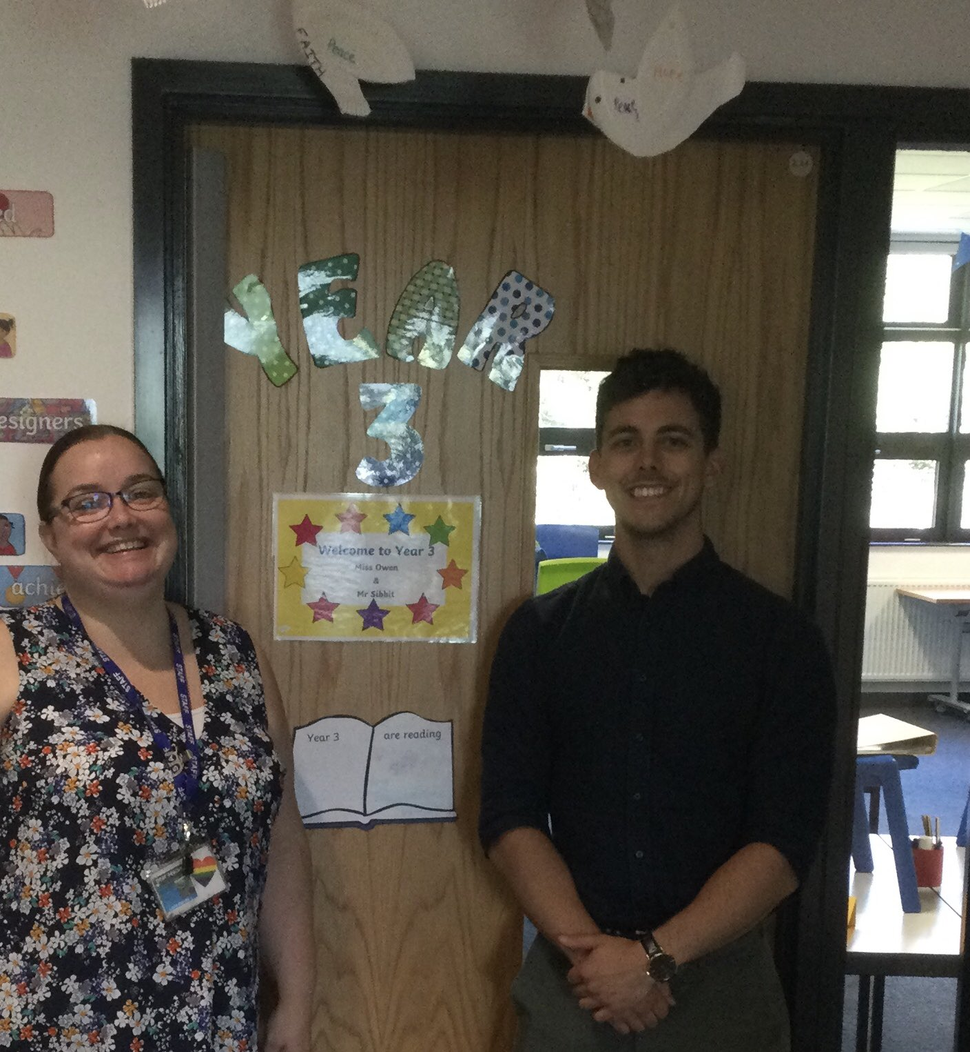
The Team and how to contact the teacher
Teacher: Miss Owen Teaching Assistant: Mr Sibbit
vowen@victoriousacademies.org

Slide 3
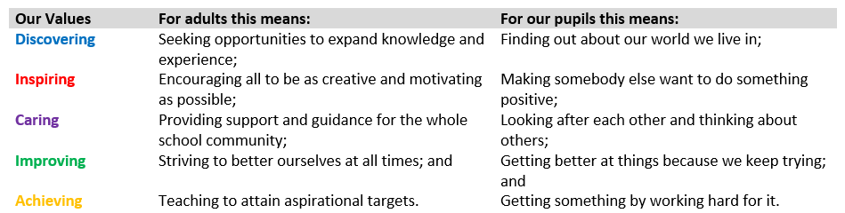
Our Values

Slide 4
Our Curriculum
Three key drivers are interwoven into the curriculum:
Cultural diversity;
Gender Equality and
the value of education
History and Geography lead the themes.
Themed learning days
Trips, visits, hooks and experiences

Slide 5
The Year 3 Overview

Slide 6
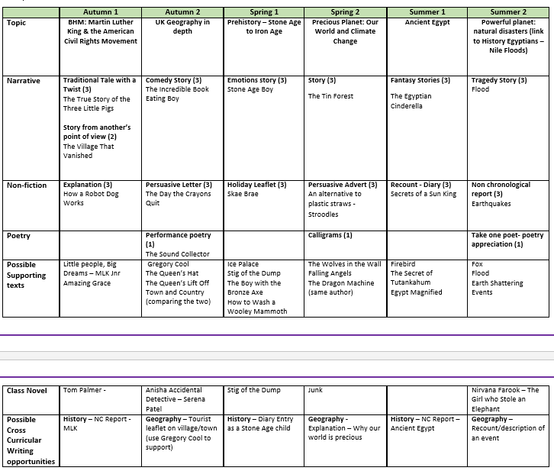
The Year 3 Overview

Slide 7
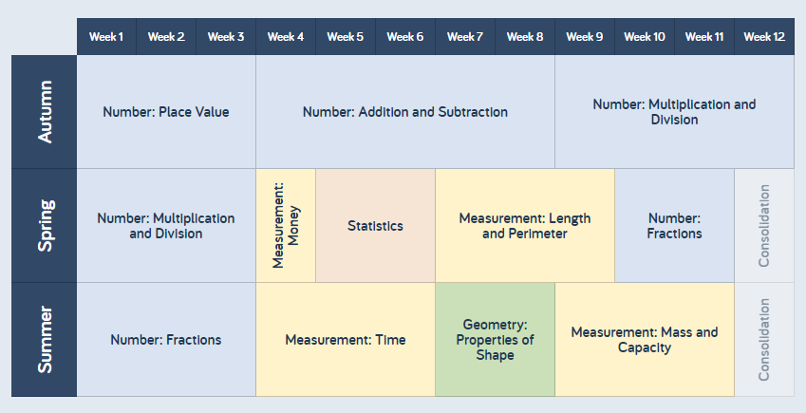
The Year 3 Overview

Slide 8
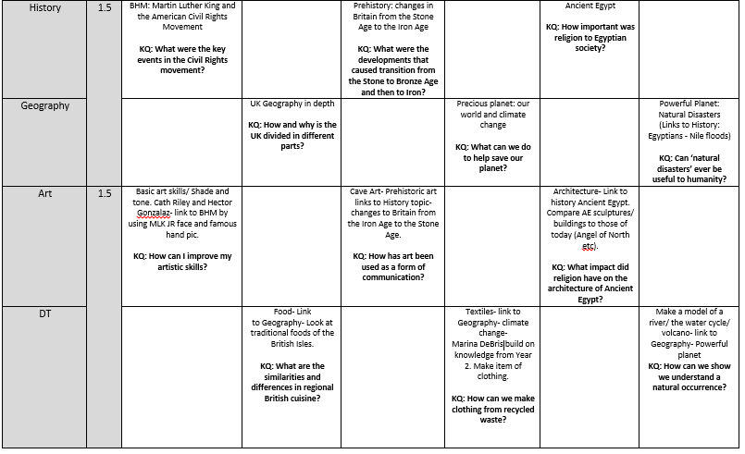
The Year 3 Overview

Slide 9
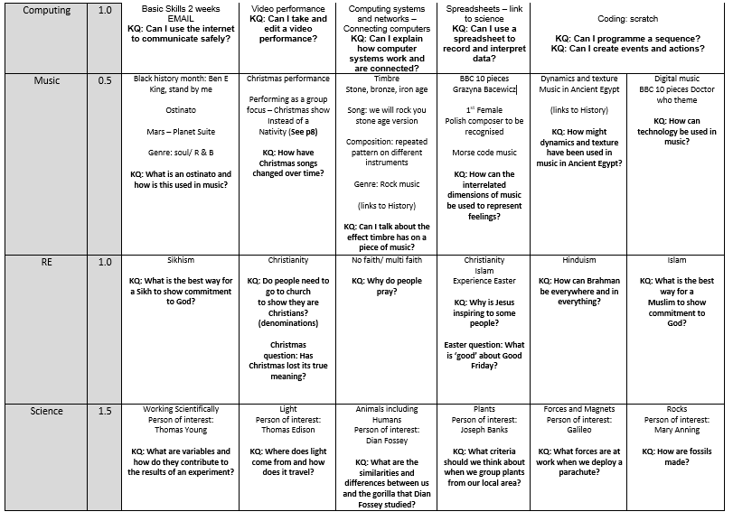
The Year 3 Overview

Slide 10
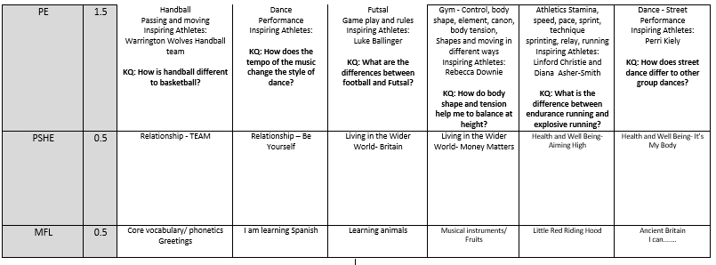
The Year 3 Overview

Slide 11
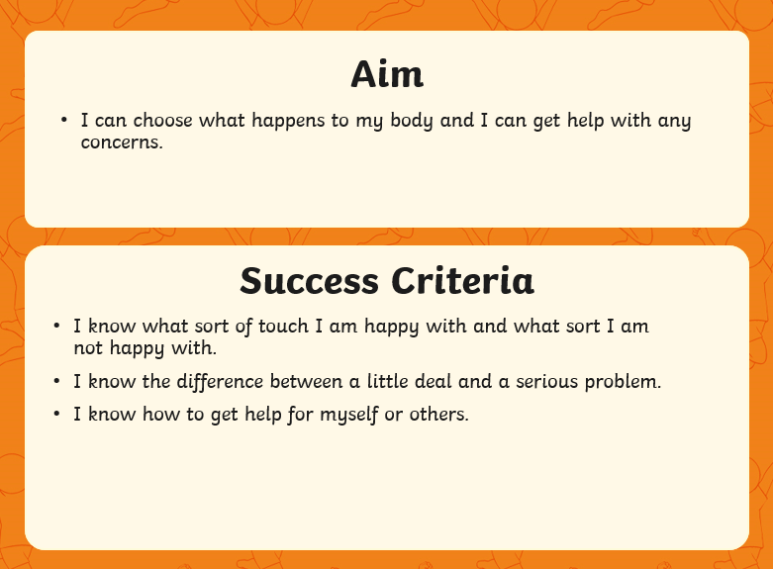

The Statutory Relationships Education curriculum Health and Well Being It’s my body SUMMER 2
Notes:
Put here what term you do Relationships education and a brief overview of what you will cover from the Twinkl resources

Slide 12
Reading Books
Little and often is the key.
-If your child is on Phase 2 - 6 (see reading book sticker) x 3 per week -with comments from parent each time
- If your child is on Turquoise or above - Parent read and make comment 1 x per week. Child read and make comment about tricky words, pages read etc. at least 2 x per week.

Slide 13
Homework
Task - 1 piece of home learning on google classroom which should be independent work and take 10 mins - to be completed by Wednesday
Reading
-If your child is on Phase 2 - 6 (see reading book sticker) x 3 per week -with comments from parent each time
- If your child is on Turquoise or above - Parent read and make comment 1 x per week. Child read and make comment about tricky words, pages read etc. at least 2 x per week.
Lexia - Minimum of 10 mins per week
Times tables Rock Stars - Minimum of 2 x 10 min sessions
NO classes will be sending home spellings to learn but will be specific lessons and time in class.
KS1 and KS2 additional tasks (optional)
Any home learning that a child does independently which is additional to this (such as home projects, research, writing stories, practicing maths concepts etc.) will be rewarded with DoJo's.

Slide 14
Uniform and Equipment
The Academy uniform is as follows:
Dark grey skirt, shorts or trousers.
Light blue polo shirt (with or without Academy logo).
Dark blue sweater or cardigan with Academy logo.
Blue and white checked summer dresses.
Socks/tights – white, navy, black or grey. No patterns or characters.
Shoes
Black shoes (not boots or trainer style shoes) - sensible, flat and without flashing heels.
Wellies can be worn when the children are in the school grounds.
During periods of inclement weather pupils may wear black leather style boots (not Ugg style).
PE kit is as follows:
Black sports shorts and plain white t-shirt
Black pumps or trainers without flashing heels

Slide 15
Uniform and Equipment
Hair accessories – bobbles, clips and headbands should be white, black, blue or green and MUST NOT have bows, glitter or embellishments.
Jewellery - pupils may wear a watch and one pair of plain studs only whilst at the academy.
Make-up - make-up including nail varnish, temporary tattoos and lip gloss should not be worn to the academy.
Sun hats - must be in school colours of dark blue, white or checked. The Academy do have an Academy baseball cap that is available to purchase.
Headwear as part of religious observance - the appropriate garment should be in school colours of dark blue, checked or white. These should not have glitter or embellishments.
Hats - Plain blue or Discovery branded - no other colours and no patterns/pictures/logos
All clothing and footwear should be clearly labelled with the child’s name.

Slide 16
Thank you
Any Questions
infodiscoveryhyde@victoriousacademies.org
boldham@victoriousacademies.org
vowen@victoriousacademies.org

